Slide 1
COPING IN CHAOTIC TIMES:
Naomi Rodda, LCSW
Director, Home & Community-Based Services
MPTF

Slide 2
Coping Skills: What’s Your Style?
Solution Focused Coping
Usually consists of engagement, information gathering, problem-solving and learning new skills as it relates to managing stressors. Is generally viewed as an active and more effective way of dealing with stress as compared with emotion focused coping. Works well for people who perceive that they have some control over the stress in their lives.
Emotion Focused Coping
Usually consists of releasing pent-up emotions, employing distraction techniques, and using humor to diffuse and deflect stress. Is sometimes viewed as a passive and less effective way of dealing with stress, but works well for people who perceive that there is little that can be done to change the stressor or situation.
-Lazarus & Folkman, Stress, Appraisal & Coping

Slide 3
Normalizing Anxiety

Slide 4
Self-Care

Slide 5
Finding Purpose

Slide 6
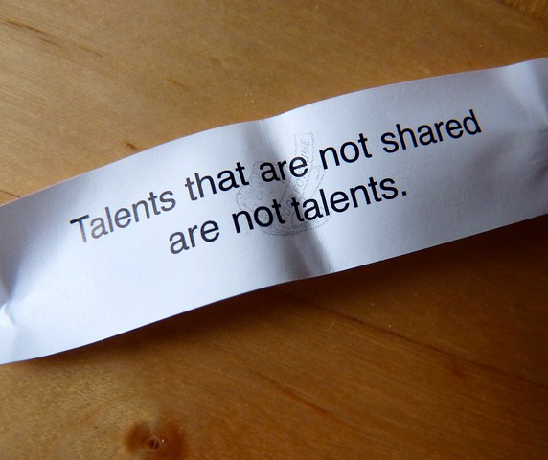
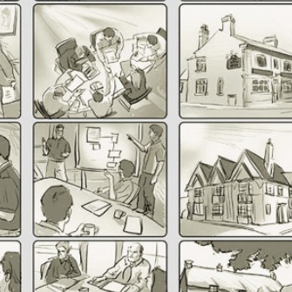
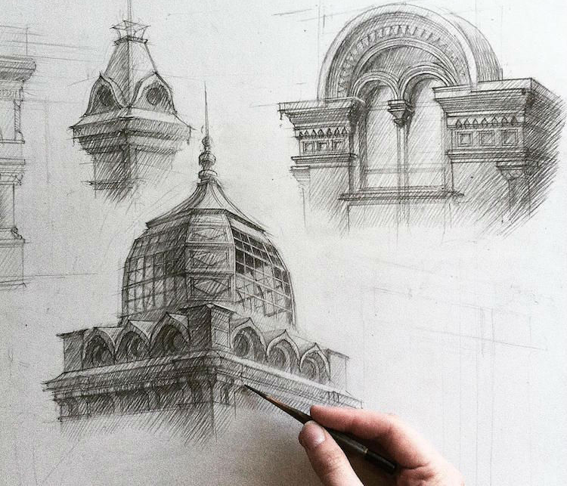
Playing to Strengths & Using Your Talents

Slide 7
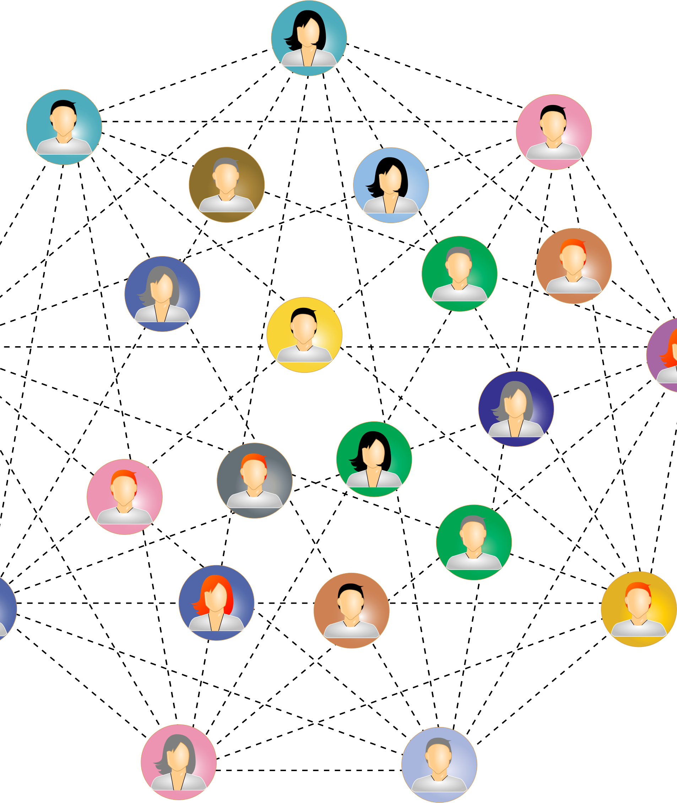
Staying Emotionally Connected

